Slide 1

The National University of Computer and Emerging Sciences
Unsupervised Learning
Machine Learning for Data Science
Dr. Akhtar Jamil
Department of Computer Science

Slide 2
Goals
Review of Previous Lecture
Today’s Lecture
DBSCAN Clustering Algorithm

Slide 3
Review of Previous Lecture

Slide 4
Centroid Initialization
We randomly select initial centroids in K-Means clustering algorithm.
initialization sensitivity
There are two approaches to avoid initialization sensitivity:
Repeat K-means: Repeating the algorithm and initialization of centroids several times and pick the clustering approach that has a small intra-cluster distance and large inter-cluster distance.
K-Means++: K-Means++ is a smart centroid initialization technique.

Slide 5
Hierarchical Clustering
Build a tree-based hierarchical taxonomy (dendrogram) from a set of unlabeled examples.
Recursive application of a standard clustering algorithm can produce hierarchical clustering.
animal
vertebrate
invertebrate
fish reptile amphib. mammal worm insect crustacean

Slide 6
Hierarchical clustering
Hierarchical clustering is a method of cluster analysis that is used to cluster similar data points together.
Hierarchical clustering follows either the top-down or bottom-up method of clustering.
There are two types of hierarchical clustering methods:
Divisive Clustering
Agglomerative Clustering

Slide 7
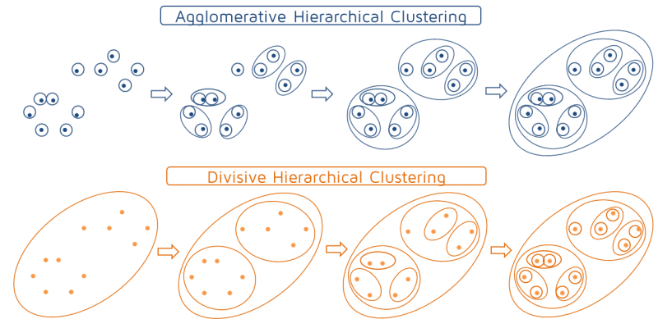
Hierarchical clustering

Slide 8
Today’s Lecture

Slide 9
Density-based Clustering
Density based clustering algorithms forms clusters based on the density of regions.
A dense cluster is a region which is “density connected”
The density of points in that region is greater than a minimum threshold.
They can find clusters of arbitrary shapes.
DBSCAN is an example of density-based clustering algorithm.

Slide 10
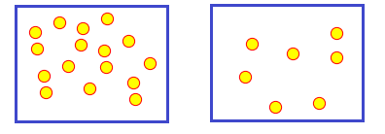
Density-based Clustering
Highly Dense Region vs Less Dense Region

Slide 11
Density-based Clustering
All clustering methods use almost the same approach
Calculate similarities and then add to the cluster
k-means is generally good, but:
Need to specify the number of clusters in beginning
K-Means may fail for different shapes.
Outliers can affect its performance ;
A slight change in data points might affect the clustering outcome.
DBSCAN clustering can overcome these.

Slide 12
DBSCAN Clustering Algorithm
Density-based spatial clustering of applications with noise (DBSCAN).
Published by Ester et. al. in 1996
The algorithm finds dense areas and expands these recursively to find clusters.
It can discover clusters of different shapes and sizes
Can perform well even with outliers.

Slide 13
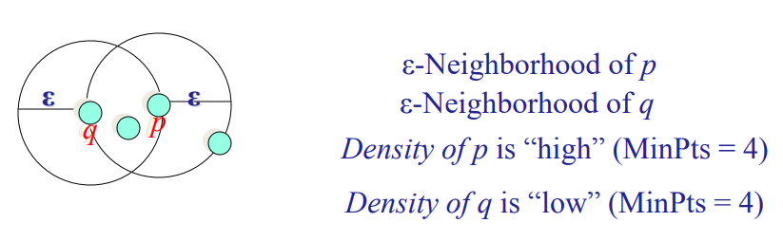
DBSCAN Clustering Algorithm
The DBSCAN algorithm uses two parameters:
eps (ε): A distance measure that will be used to locate the points in the neighborhood of any point.
minPts: The minimum number of points (a threshold) clustered together for a region to be considered dense.

Slide 14
DBSCAN Clustering Algorithm
Given ε and MinPts, categorize the data points into three exclusive groups.
Core point: Having more than a specified number of points (MinPts) within radius (ε)
Border point: It has fewer than MinPts within ε but is in the neighborhood of a core point.
Noise point: It is any point that is not a core point nor a border point.

Slide 15
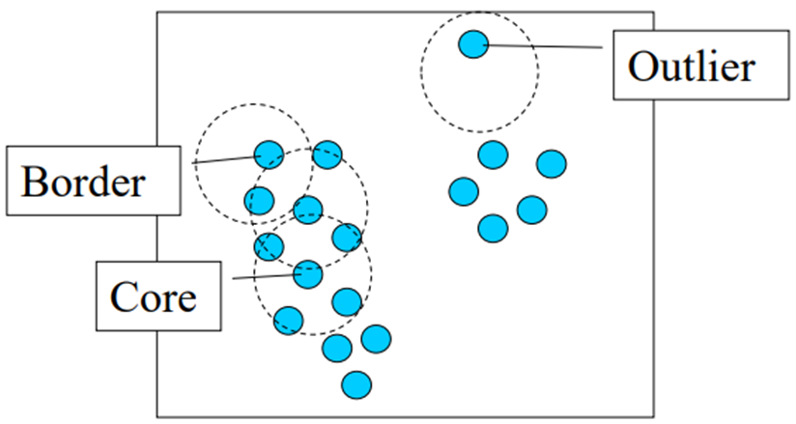
DBSCAN Clustering Algorithm
ε = 2, minPts = 4

Slide 16
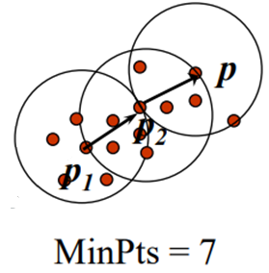
DBSCAN Clustering Algorithm
Density-Reachable (directly and indirectly):
A point p is directly density-reachable from p2
p2 is directly density-reachable from p1

Slide 17
DBSCAN Clustering Algorithm
p ← p₂ ← p₁ form a chain
p is (indirectly) density-reachable from p₁
p₁ is not density-reachable from p

Slide 18
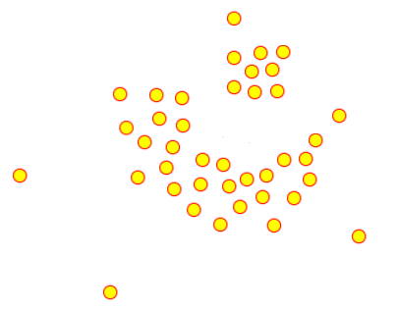
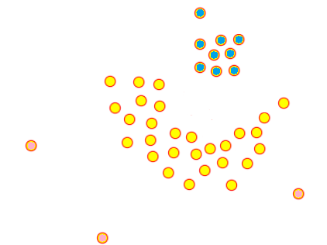
DBSCAN Clustering Algorithm
High Density

Slide 19
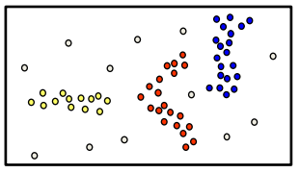
DBSCAN Clustering Algorithm
Basic idea – Clusters are dense regions in the data space, separated by regions of lower object density
A cluster is defined as a maximal set of density connected points
Discovers clusters of arbitrary shape

Slide 20
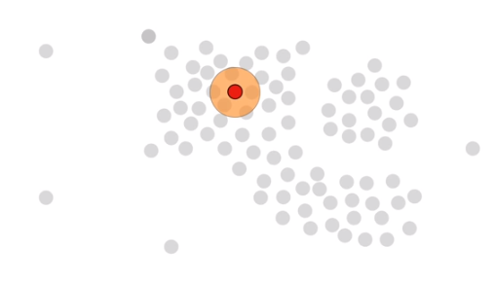
DBSCAN Clustering Algorithm

Slide 21
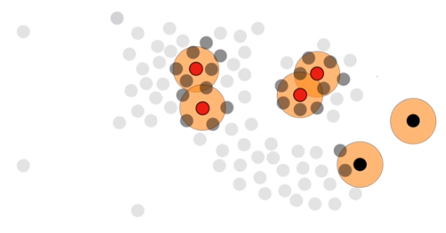
DBSCAN Clustering Algorithm

Slide 22
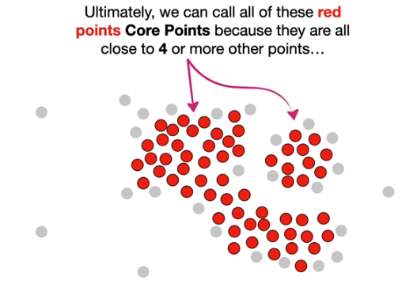
DBSCAN Clustering Algorithm

Slide 23
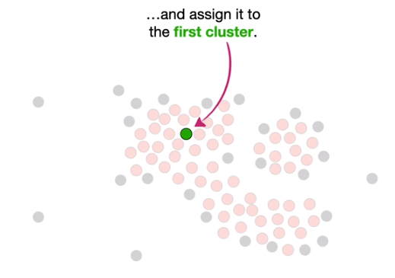
DBSCAN Clustering Algorithm

Slide 24
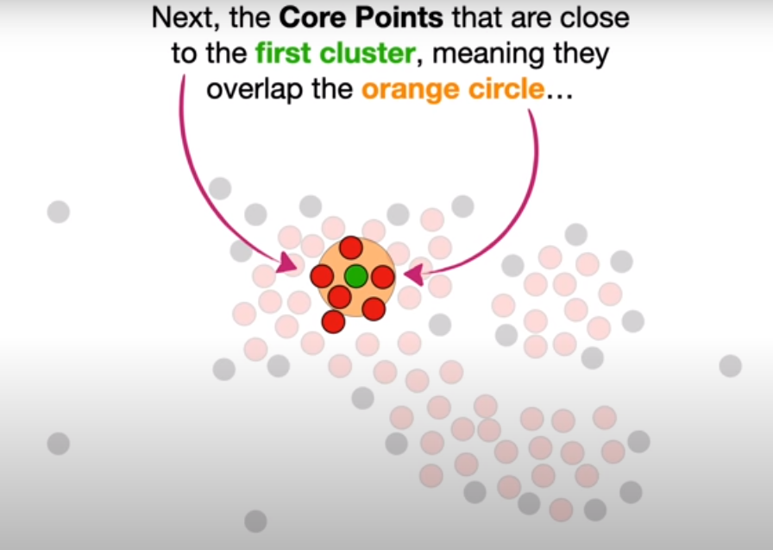
DBSCAN Clustering Algorithm

Slide 25
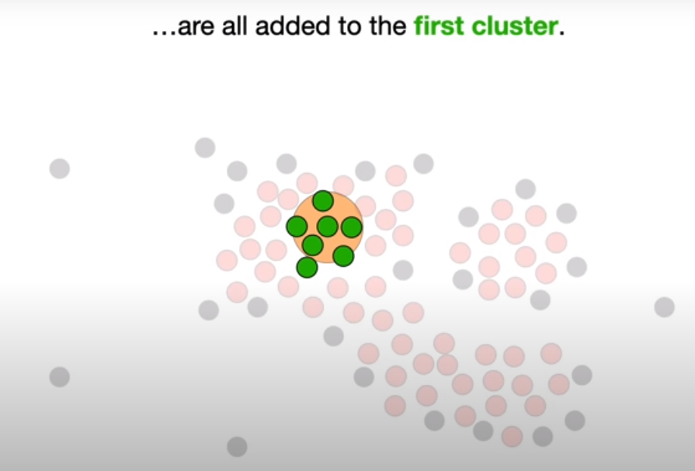
DBSCAN Clustering Algorithm

Slide 26
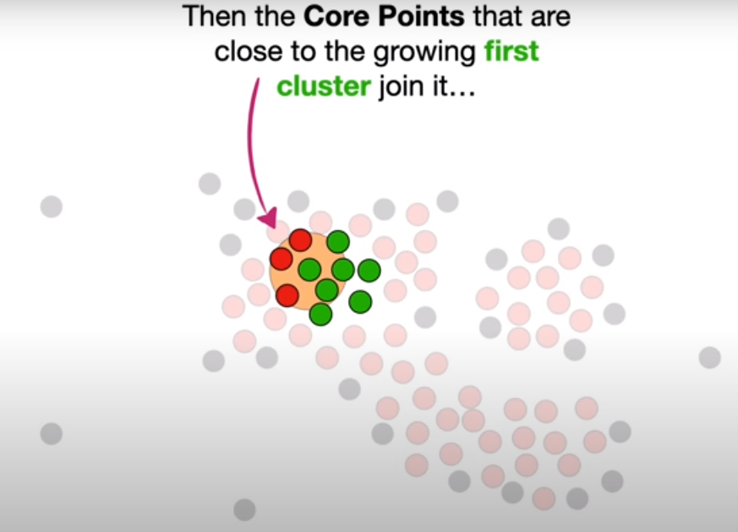
DBSCAN Clustering Algorithm

Slide 27
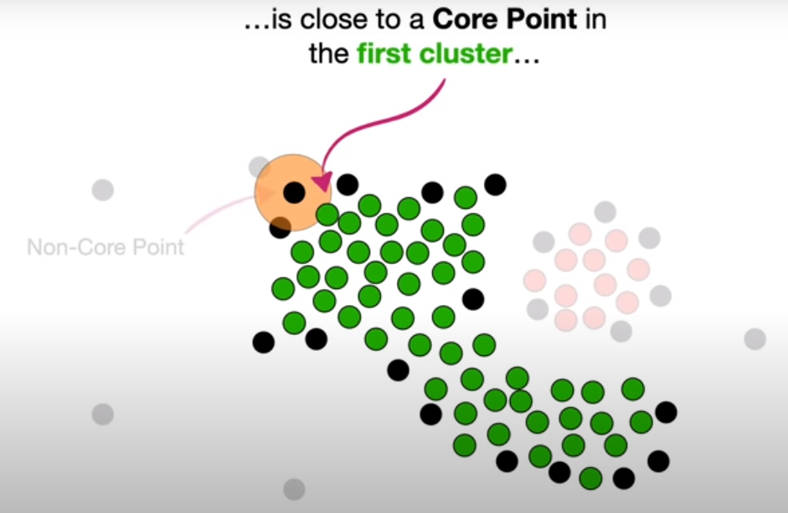
DBSCAN Clustering Algorithm

Slide 28
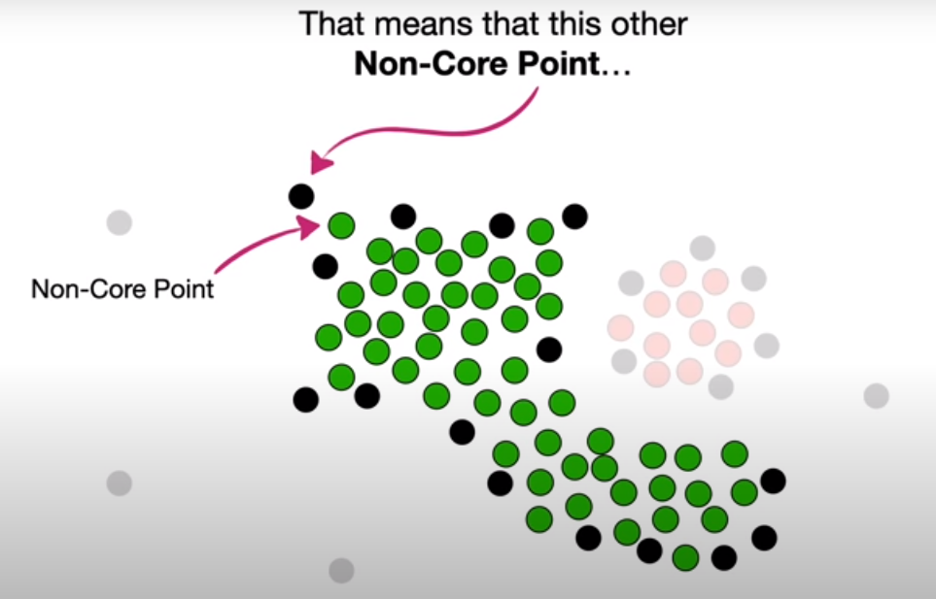
DBSCAN Clustering Algorithm

Slide 29
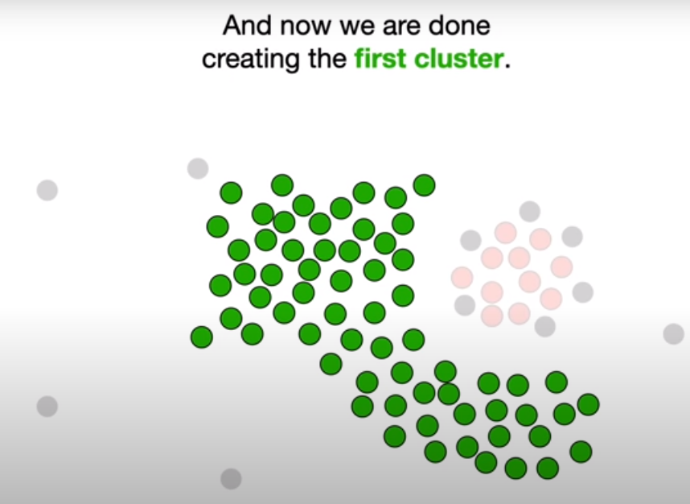
DBSCAN Clustering Algorithm

Slide 30
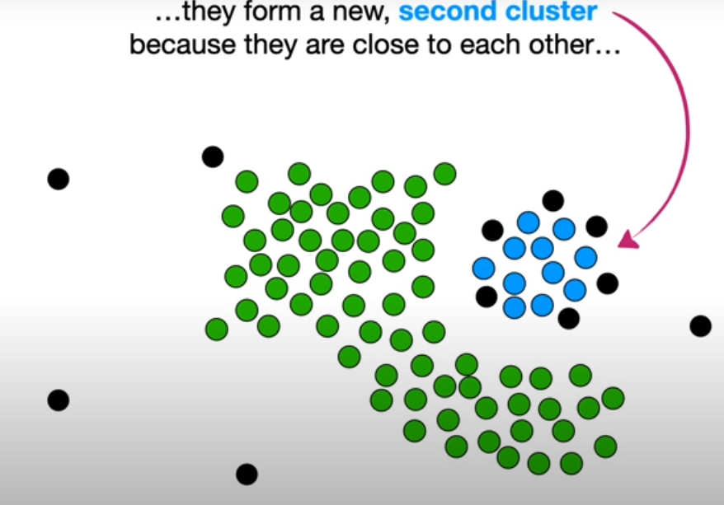
DBSCAN Clustering Algorithm

Slide 31
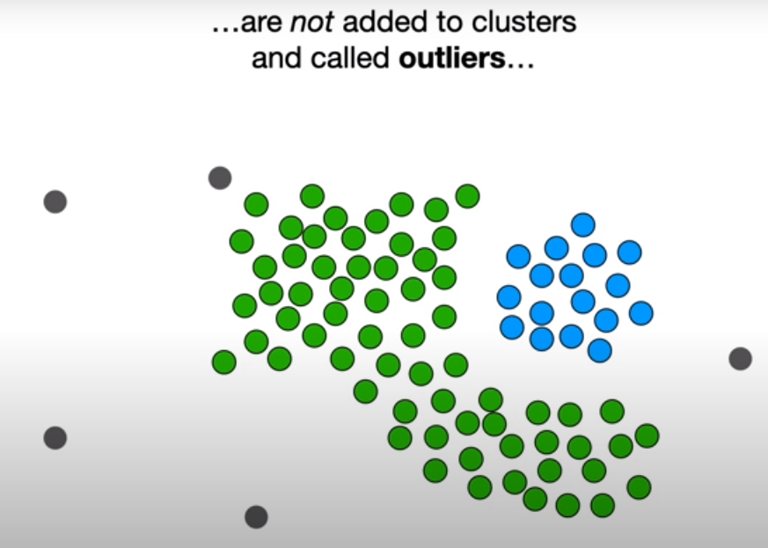
DBSCAN Clustering Algorithm

Slide 32
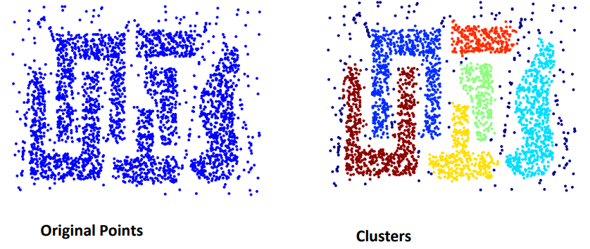
Advantages
Resistant to Noise
Can handle clusters of different shapes and sizes

Slide 33
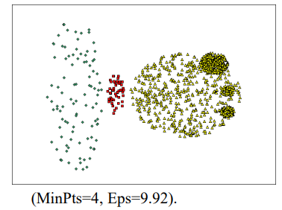
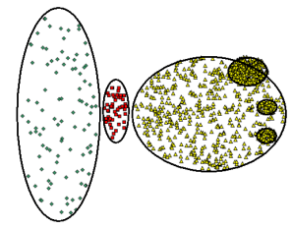
Weaknesses
Cannot handle varying densities
Sensitive to parameters—hard to determine the correct set of parameters

Slide 34
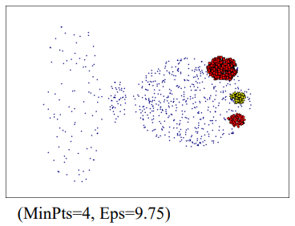
Weaknesses

Slide 35
References
Animation
https://www.naftaliharris.com/blog/visualizing-dbscan-clustering/
https://www.youtube.com/watch?v=RDZUdRSDOok&t=294s&ab_channel=StatQuestwithJoshStarmer
https://www.naftaliharris.com/blog/visualizing-dbscan-clustering/

Slide 36
Thank You ☺

